Slide 1
Learning to Sketch: Seeing the Visual World through the Eyes of Deep Neural Networks
Demonstration for NeurIPS 2022 Education Outreach Program
Bhumika Mistry

Slide 2
Examples of Artificial Intelligence (AI):
Predictive text on your mobile
Smart assistants like Alexa
Snapchat to track your face movement

Slide 3
What's this demo about?
Teach AI machines, called models, to sketch
Models are not physical objects
They're a bunch of learnt instructions for a computer to follow
AI goal: do tasks that humans do well
Sketching is a very human thing to do; you find it easy but a machine will find it hard!
Teaching models to sketch = get to understand how these models see the world
Improve understanding on models = build even better applications!

Slide 4
How to learn to sketch?

Slide 5
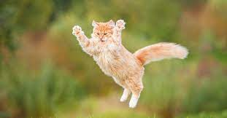
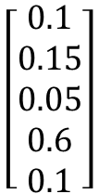
Image classification
Researchers have taught models how to get really good at a task called image classification
E.g., What is the object in a picture?
vector
Magic box #1
$$\left[\begin{aligned}0.1 \\ 0.15 \\ 0.05 \\ 0.6 \\ 0.1\end{aligned}\right]$$
More math magic
Cat

Slide 6


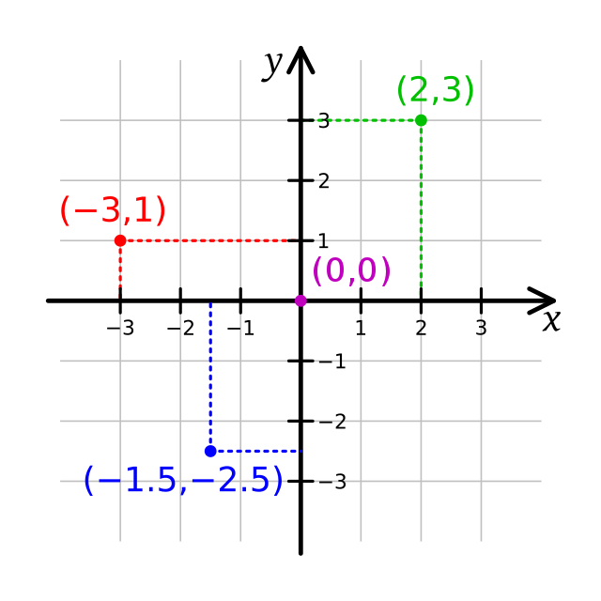
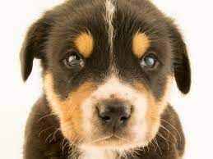


Vectors
Model has a 'magic box #1' which spits out a list of numbers (called a vector)
Similar images will be close to each other in the vector space

Slide 7
Making a sketch
Draw a bunch of lines
How to draw a line?
4 numbers (start and end coordinates)
Start off with random lines but learns where to put them over time
Coordinates → magic box #2 (differentiable rasterizer) → sketch

Slide 8
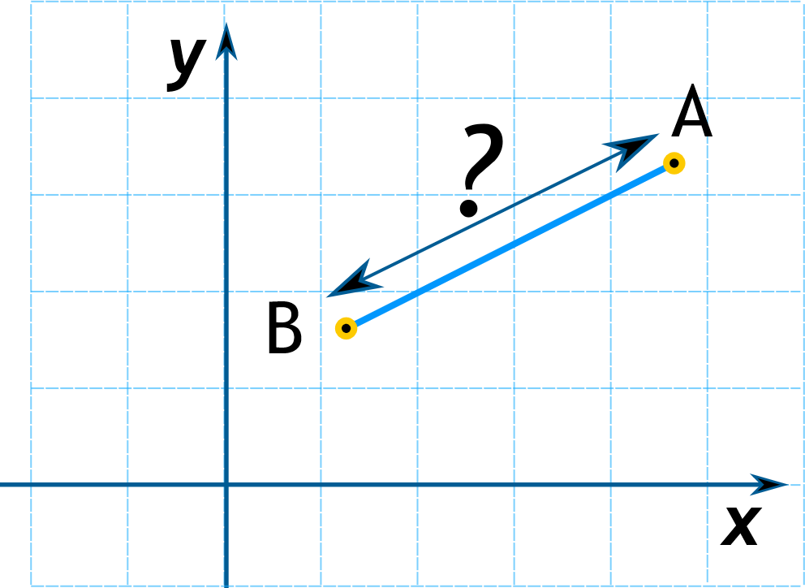
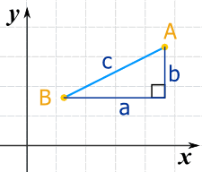
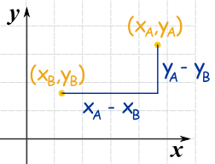
Learning the line coordinates
Want the sketch to look like the original image
Need way to measure the difference between them = Loss
Similar = little change; Different = big change
Compare vectors
(Remember magic box #1 from earlier?)
Measure the difference of the 2 vectors and calculate a loss
Measure using method called Mean Squared Error (MSE)
(Just a bit of Pythagoras)

Slide 9
Bringing it all together…

Slide 10
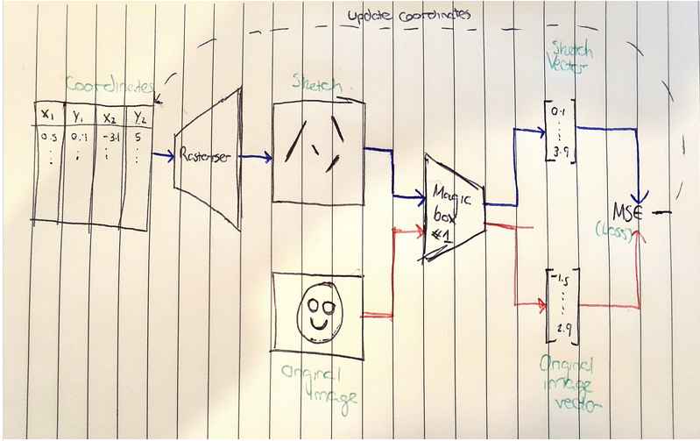

Slide 11
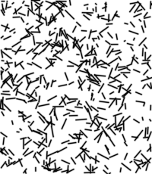
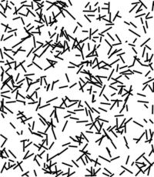
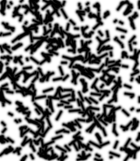
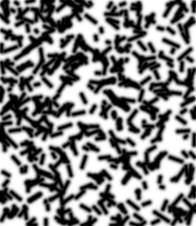
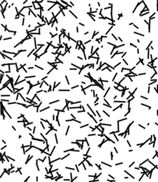

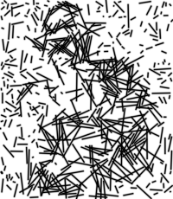
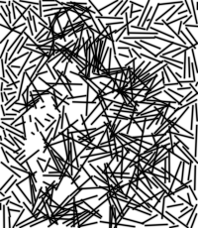
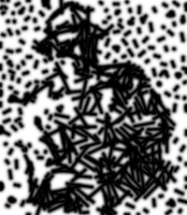
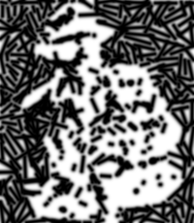
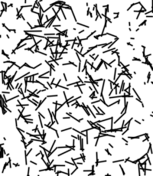
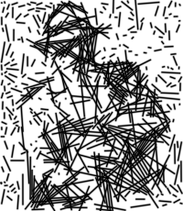
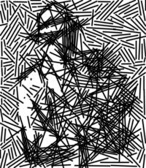
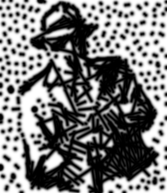

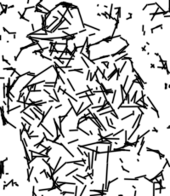
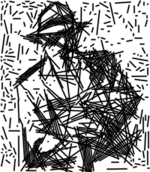
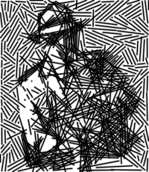
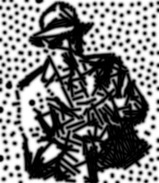

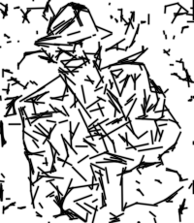
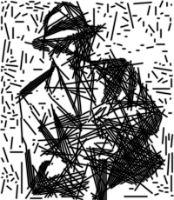
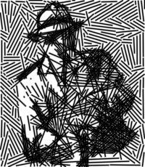
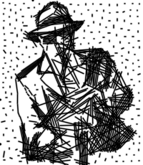
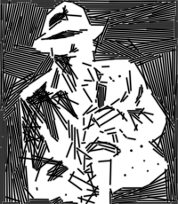

Iteration | MSE | Blurred MSE | MSE (tick to thin) | MSE inverted (tick to thin) | Feature Map
0
10
20
50
500

Slide 12
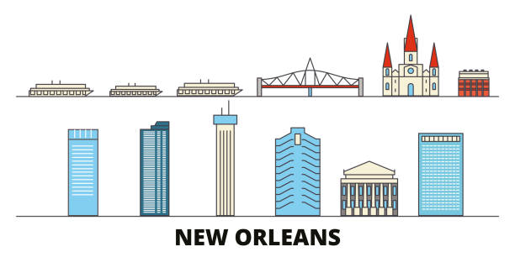
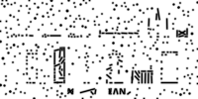
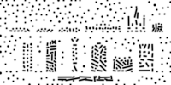
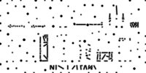
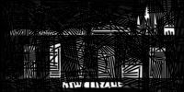
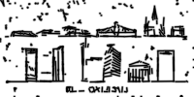






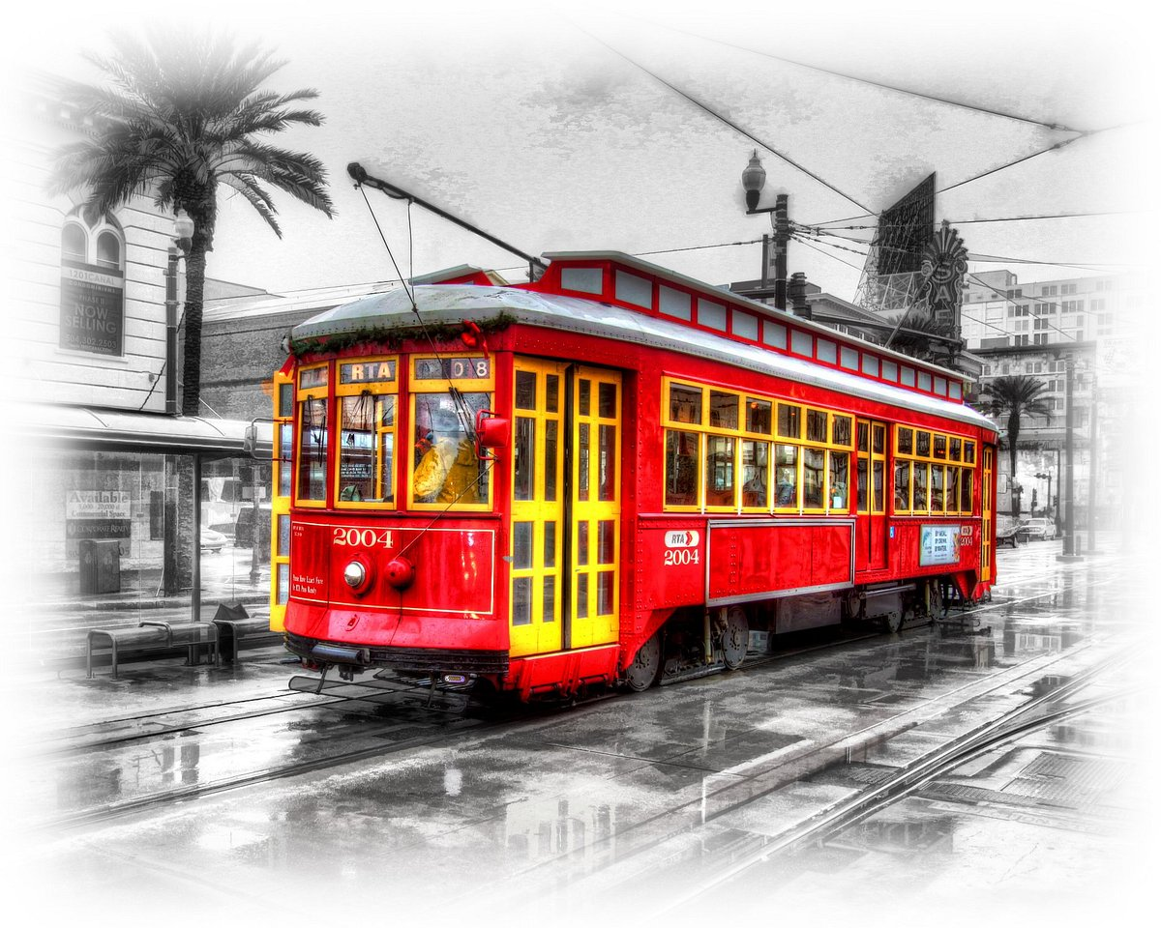
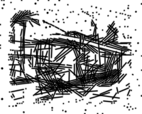
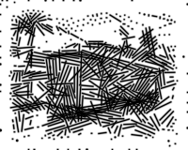
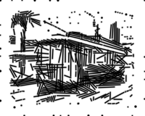
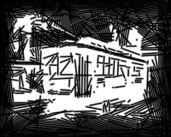
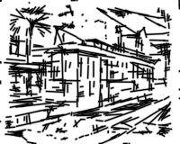

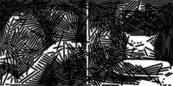
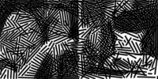
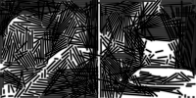
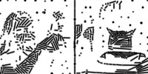
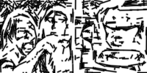

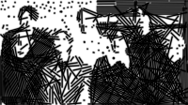
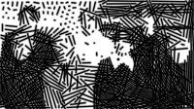
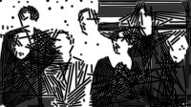


Original | MSE | Blurred MSE | MSE (tick to thin) | MSE inverted (tick to thin) | Feature Map

